Slide 1
UNIT IV
– Schema refinement
– Problems Caused by redundancy
– Decompositions –
– Problem related to decomposition
– reasoning about FDS –
– FIRST, SECOND, THIRD Normal forms
– BCNF
– Lossless join Decomposition
– Dependency preserving Decomposition
– Schema refinement in Data base Design
– Multi valued Dependencies
– FOURTH Normal Form.

Slide 2
Review: Database Design
Requirements Analysis
  user needs; what must database do?
Conceptual Design
  high level descr (often done w/ER model)
Logical Design
  translate ER into DBMS data model
Schema Refinement
  consistency ,normalization
Physical Design - indexes, disk layout
Security Design - who accesses what
Schema Refinement
Schema Refinement is the process that re-defines the schema of a relation.
A refinement approach is based on decompositions.
Decomposition can eliminate the redundancy.
Schema-Refinement addresses the following problems:
i) problems caused by redundancy
ii) problems caused by decomposition.

Slide 3
Problems Caused by Redundancy
Storing the same information redundantly, that is, in more than one place within a database, can lead to several problems:
Redundant storage: Some information is stored repeatedly
Update anomalies: If one copy of such repeated data is updated, an inconsistency is created unless all copies are similarly updated
Insertion anomalies: It may not be possible to store some information unless some other information is stored as well
Deletion anomalies: It may not be possible to delete some information without losing some other information as well

Slide 4
Consider a relation obtained by translating a variant of the Hourly_Emps entity set Hourly_Emps(ssn, name, lot, rating, hourly_wages, hours_worked)
We will often abbreviate an attribute name to a single letter and refer to a relation schema by a string of letters, one per attribute
For example, we will refer to the Hourly_Emps schema as SNLRWH (W denotes the hourly wages attribute)
The key for Hourly_Emps is ssn
In addition, suppose that the hourly_wages attribute is determined by the rating attribute. That is, for a given rating value, there is only one permissible hourly_wages value
This IC is an example of a functional dependency
It leads to possible redundancy in the relation Hourly_Emps, as illustrated in Figure 15.1
If the same value appears in the rating column of two tuples, the IC tells us that the same value must appear in the hourly_wages column as well

Slide 5
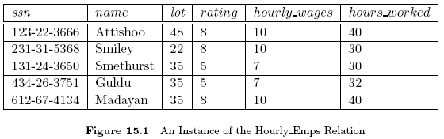

Slide 6
This redundancy has several negative consequences:
1. Some information is stored multiple times. For example, the rating value 8 corresponds to the hourly wage 10, and this association is repeated three times
In addition to wasting space by storing the same information many times, redundancy leads to potential inconsistency
For example, the hourly_wages in the first tuple could be updated without making a similar change in the second tuple, which is an example of an update anomaly
Also, we cannot insert a tuple for an employee unless we know the hourly wage for the employee's rating value, which is an example of an insertion anomaly
2. If we delete all tuples with a given rating value (e.g., we delete the tuples for Smethurst and Guldu) we lose the association between that rating value and its hourly_wage value (a deletion anomaly)

Slide 7
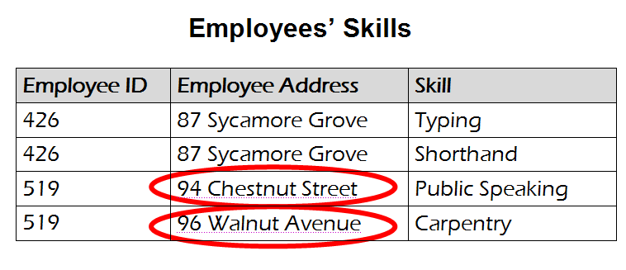
Example
An update anomaly. Employee 519 is shown as having different addresses on different records

Slide 8
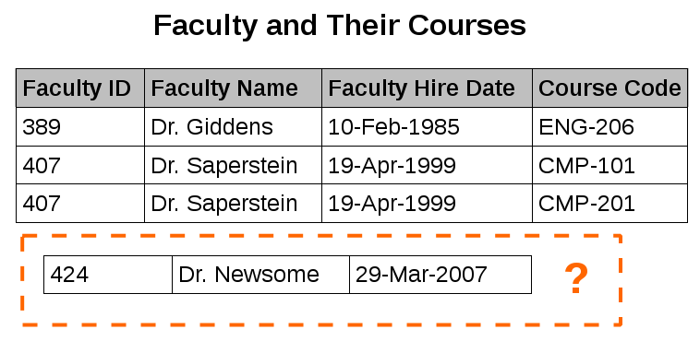
An insertion anomaly. Until the new faculty member, Dr. Newsome, is assigned to teach at least one course, his details cannot be recorded.

Slide 9
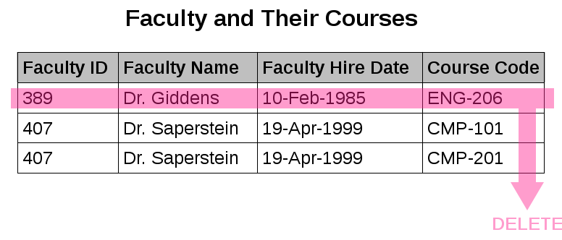
A deletion anomaly. All information about Dr. Giddens is lost when he temporarily ceases to be assigned to any courses

Slide 10
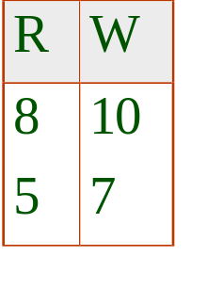
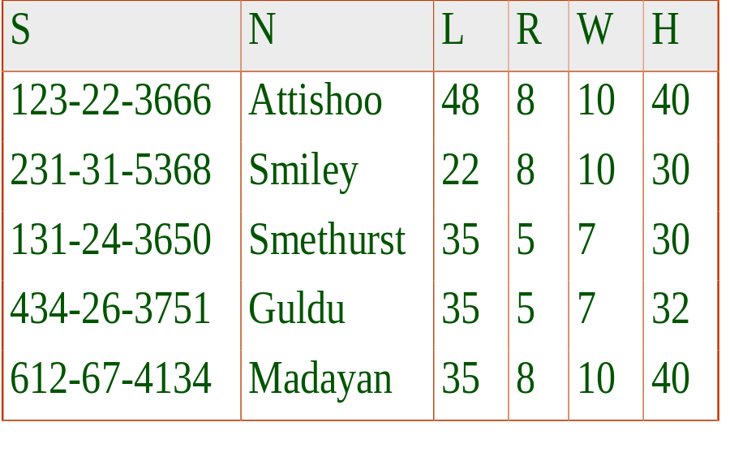
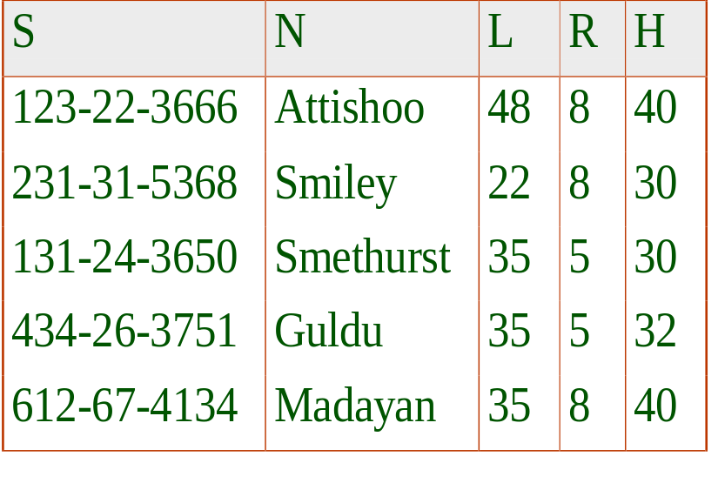
Decomposition of a Relation Scheme
Suppose that relation R contains attributes A1 ... An. A decomposition of R consists of replacing R by two or more relations such that:
  Each new relation scheme contains a subset of the attributes of R (and no attributes that do not appear in R), and
  Every attribute of R appears as an attribute of one of the new relations.
Intuitively, decomposing R means we will store instances of the relation schemes produced by the decomposition, instead of instances of R.
Wages
Hourly_Emps2
Notes:
26

Slide 11
Problems Related to Decomposition
Unless we are careful, decomposing a relation schema can create more problems than it solves
Two important questions must be asked repeatedly:
  1.Do we need to decompose a relation?
  2.What problems (if any) does a given decomposition cause?
To help with the first question, several normal forms have been proposed for relations
If a relation schema is in one of these normal forms, certain kinds of problems cannot arise
Considering the normal form of a given relation schema can help us to decide whether or not to decompose it further
If we decide that a relation schema must be decomposed further, we must choose a particular decomposition (i.e., a particular collection of smaller relations to replace the given relation)

Slide 12
With respect to the second question, two properties of decompositions are of particular interest
The lossless-join property enables us to recover any instance of the decomposed relation from corresponding instances of the smaller relations
The dependency-preservation property enables us to enforce any constraint on the original relation by simply enforcing some constraints on each of the smaller relations
That is, we need not perform joins of the smaller relations to check whether a constraint on the original relation is violated
A serious drawback of decompositions is that queries over the original relation may require us to join the decomposed relations

Slide 13
Functional dependencies:
  a form of integrity constraint that can identify schemas with problems and suggest refinements.
Main refinement technique: decomposition
  replacing ABCD with, say, AB and BCD, or ACD and ABD.
Let R be a relation schema and let X and Y be nonempty
sets of attributes in R.
We say that an instance r of R satisfies the FD X→ Y
if the following holds for every pair of tuples t1 and t2 in r
An FD X→ Y essentially says that if two tuples agree on the values in attributes X, they must also agree on the values in attributes Y.
If t1.X = t2.X, then t1.Y = t2.Y
The notation t1.X refers to the projection of tuple t1 onto the attributes in X

Slide 14
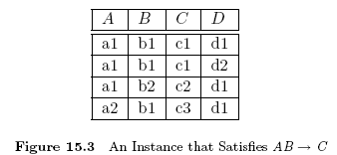
Note: is read as X functionally determines Y, or simply as X determines Y
Figure 15.3 illustrates the meaning of the by showing an instance that satisfies this dependency
Recall that a legal instance of a relation must satisfy all specified ICs, including all specified Fds
A primary key constraint is a special case of an FD.The attributes in the key play the role of X, and the set of all attributes in the relation plays the role of Y

Slide 15
Note:
A functional dependency must be identified based on
semantics of application, not on individual relation instances.
The semantics of an application is a set of constraints imposed by the application.
This set of constraints are set up either explicitly or implicitly.
Explicitly: by users Implicitly: by ‘common sense’

Slide 16
Example:
Application is to keep track of information about
employees in a company.
Information to be kept track of includes:
eid: employee’s id number
ename: employee name
address: address of employee
gender: employee’s gender
dname: department name
dhname:department heads name
dhgender:dept head’s gender
Given
a:Employee’s id number is unique
b:Each employee works for only one dept.
c:A person can be the head of at most one department
d:All department heads have different names
Implicit: common sense
Which of the following dependencies are true?
  eid → ename
  ename → eid
  eid → address
  eid → gender
  gender → address
  dhname → dname
  dhname → eid
8.dhgender →address
√
×
√
√
×
Let’s construct a relation schema as follows:
√
×
×
Employee
eid
ename
address
gender
dname
dhname
dhgender

Slide 17


Reasoning About FDs
Given some FDs, we can usually infer additional FDs:
  ssn did, did lot implies ssn lot
An FD f is implied by a set of FDs F if f holds whenever all FDs in F hold.
  = closure of F is the set of all FDs that are implied by F.
Armstrong’s Axioms (X, Y, Z are sets of attributes):
  Reflexivity: If X ⊇ Y, then X Y
  Augmentation: If X Y, then XZ YZ for any Z
  Transitivity: If X Y and Y Z, then X Z
These are sound and complete inference rules for FDs!
Couple of additional rules (that follow from AA):
  Union: If X → Y and X → Z,then X → YZ(XX →XY and XY→YZ; XX→YZ)
  Decomposition: If X → YZ, then X → Y and X → Z (YZ→Y and YZ →Z)
Example: Contracts(cid,sid,jid,did,pid,qty,value), and:
  C is the key: C → CSJDPQV
  A project purchases a given part using a single contract: JP → C
  A dept purchases at most one part from a supplier: SD → P
JP → C, C → CSJDPQV imply JP → CSJDPQV
SD → P implies SDJ → JP
SDJ → JP, JP → CSJDPQV imply SDJ → CSJDPQV
Notes:
19

Slide 18
R = (A, B, C, G, H, I)
F = { A → B, A → C ,CG → H , CG → I , B → H}
some members of F⁺
A → H (by transitivity from A → B and B → H)
AG → I (by AG → CG, and then transitivity with CG → I )
CG → HI (by CG → I and CG → H)

Slide 19
Example: Suppose we are given a Relation schema R with attributes A, B, C, D, E, F, and the FDs A → BC, B → E, CD → EF
Show that the FD AD → F holds for R and is thus a member of the closure of the given set:
Ans:
1. A → BC (given)
2. A → C (1, decomposition)
3. AD → CD (2, augmentation)
CD → EF (given)
5. AD → EF (3 and 4, transitivity)
6. AD → F (5, decomposition)

Slide 20
Attribute Closure
If we just want to check whether a given dependency, say,
, is in the closure of a set F of FDs, we can do so efficiently without computing
We first compute the attribute closure with respect to F, which is the set of attributes A such that can be inferred using the Armstrong Axioms
The algorithm for computing the attribute closure of a set X of attributes is shown in Figure 15.6

Slide 21
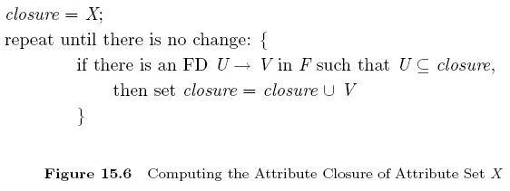
This algorithm starts with attribute X and stops as soon as there is no change in the closure
By varying the starting attribute and the order in which the algorithm considers FDs, we can obtain all candidate keys

Slide 22
Example: Suppose we are given a relation schema R with attributes A, B, C, D, E, F and FDs: A → BC, E → CF, B → E, CD → EF
Compute the closure {A,B} ⁺ of the set of attributes {A,B} under this set of FDs
Ans:
Initialize the closure to {A,B}
Go through inner loop 4 times, once for each of the given FDs
i) FD A → BC, here A is a subset of closure, so add B and C to closure (closure ={ A,B,C})
ii) FD E → CF, do not add C and F to closure, because E is not a subset of closure
iii) FD B → E, add E to closure (closure ={ A,B,C,E})
iv) FD CD → EF, do not add F to closure
now closure={ A,B,C,E}

Slide 23
3. Go through inner loop 4 times, once for each of the given FDs
i) FD A → BC, no change in closure
ii) FD E → CF, closure ={ A,B,C,E,F}
iii) FD B → E, no change in closure
iv) FD CD → EF, no change in closure
4. Go through inner loop 4 times, once for each of the given FDs. Closure does not change so the process terminates. so closure of {A,B} ⁺ ={ A,B,C,E,F}

Slide 24
Find the closure of the attributes A and B.
R = (A, B, C, D, E). F = {A→BC, CD→E, B→D, E→A}.
Compute A⁺ and B⁺.
A⁺ = A because A→A
= ABC because A→BC
= ABCD because B→D
= ABCDE because CD→E
B⁺ = B because B→B
= BD because B→D

Slide 25
Canonical Cover
Sets of functional dependencies may have redundant dependencies that can be inferred from the others
  For example: A → C is redundant in: {A → B, B → C}
  Parts of a functional dependency may be redundant
    E.g.: on RHS: {A → B, B → C, A → CD} can be simplified to
    {A → B, B → C, A → D}
Intuitively, a canonical cover of F is a “minimal” set of functional dependencies equivalent to F, having no redundant dependencies or redundant parts of dependencies

Slide 26
Computing a Canonical Cover
R = (A, B, C)
F = {A → BC
B → C
A → B
AB → C}
Combine A → BC and A → B into A → BC
  Set is now {A → BC, B → C, AB → C}
A is extraneous in AB → C
  Check if the result of deleting A from AB → C is implied by the other dependencies
    Yes: in fact, B → C is already present!
  Set is now {A → BC, B → C}
C is extraneous in A → BC
  Check if A → C is logically implied by A → B and the other dependencies
    Yes: using transitivity on A → B and B → C.
      Can use attribute closure of A in more complex cases
The canonical cover is: A → B
B → C

Slide 27
Attribute Closure (example)
R = {A, B, C, D, E}
F = { B →CD, D → E, B → A, E → C, AD →B }
Is B → E in F⁺ ?
B⁺ = B
  B⁺ = BCD
  B⁺ = BCDA
  B⁺ = BCDAE … Yes! and B is a key for R too!
Is D a key for R?
  D⁺ = D
  D⁺ = DE
  D⁺ = DEC
  … Nope!
Is AD a key for R? AD⁺ = AD
AD⁺ = ABD and B is a key, so Yes!

Slide 28
Normalization
A series of steps followed to obtain a database
design that allows for consistent storage and
avoiding duplication of data
A process of decomposing relationships with
‘anomalies’
The normalization process passes through
fulfilling different Normal Forms
A table is said to be in a certain normal form if
it satisfies certain constraints
Originally Dr. Codd defined 3 Normal Forms,
later on several more were added
For most practical purposes databases are
considered normalized if they adhere to
3rd Normal Form
Relational db model
1st Normal Form
2nd Normal Form
3rd Normal Form
Boyce/Codd Normal Form
4th Normal Form
5th Normal Form
Normalized relational db
model

Slide 29
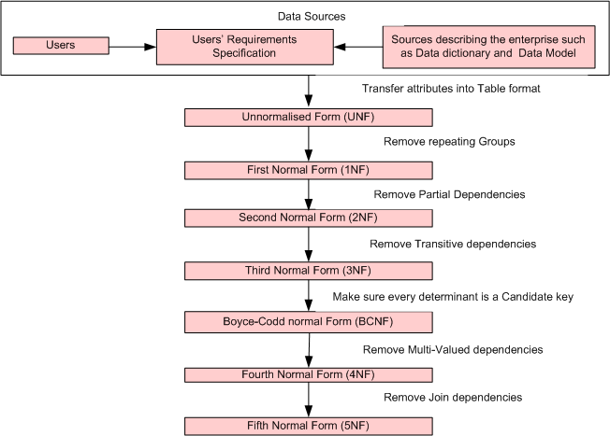

Slide 30
First Normal Form
Eliminates repeating groups.
Defines primary keys.
All records must be identified uniquely with a primary key. A primary key is unique and thus
no duplicate values are allowed.
All fields other than the primary key must depend on the primary key, either directly or indirectly.
All fields must contain a single value.
All values in each field must be of the same datatype.
Create a new table to move the repeating groups from the original table.

Slide 31
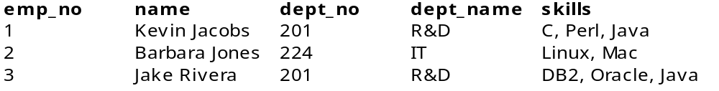
UNF
Example:
Employee
Comma delimiters Represents repeating groups
Employee
Emp_no | Name | Dept_no | Dept_name | skills
1 | Kelvin Jacobs | 201 | R&D | C
1 | Kelvin Jacobs | 201 | R&D | Perl
1 | Kelvin Jacobs | 201 | R&D | Java
2 | Barbara Jones | 224 | IT | Linux
2 | Barbara Jones | 224 | IT | Mac
3 | Jake Rivera | 201 | R&D | DB2
3 | Jake Rivera | 201 | R&D | Oracle
3 | Jake Rivera | 201 | R&D | Java
1NF

Slide 32
2nd Normal Form (2NF)
The table must be in 1NF.
All non-key values must be fully functionally dependent on the primary key. In other words,
  non-key fields not completely and individually dependent on the primary key are not allowed.
Partial dependencies must be removed. A partial dependency is a special type of functional dependency that exists when a field is fully dependant on a part of a composite primary key.
Stating the previous two points in a different way, remove fields that are independent of the primary key.
Create a new table to separate the partially dependent part of the primary key and its dependent fields.

Slide 33
Prime attribute: An attribute of relation schema R is called a prime attribute of R if it is a member of some candidate key of R
Nonprime attribute: An attribute is called nonprime if it is not a prime attribute—that is, if it is not a member of any candidate key

Slide 34
Full functional dependence—
This situation occurs where X determines Y, but X combined with Z does not determine Y.
In other words, Y depends on X and X alone. If Y depends on X with anything else, there is not full functional dependence. Essentially X, the determinant, cannot be a composite key.
A composite key contains more than one field (the equivalent of X with Z).

Slide 35
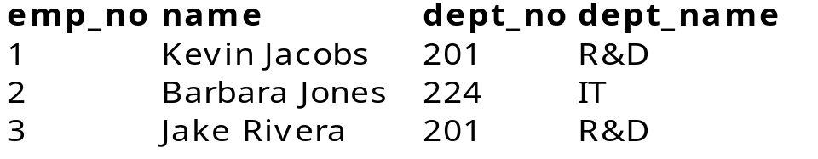
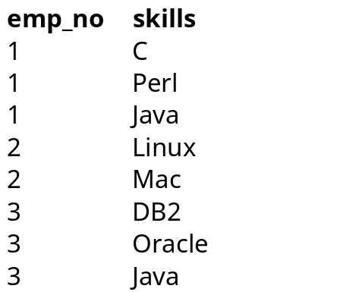
Second Normal Form (2NF)
Emp_no,skills→name
Emp_no | Name | Dept_no | Dept_name | skills
1 | Kelvin Jacobs | 201 | R&D | C
1 | Kelvin Jacobs | 201 | R&D | Perl
1 | Kelvin Jacobs | 201 | R&D | Java
2 | Barbara Jones | 224 | IT | Linux
2 | Barbara Jones | 224 | IT | Mac
3 | Jake Rivera | 201 | R&D | DB2
3 | Jake Rivera | 201 | R&D | Oracle
3 | Jake Rivera | 201 | R&D | Java
1NF
2NF
2NF
decomposition
Employee
Skills

Slide 36
Third Normal Form (3NF)
The table must be in 2NF.
It is based on the concept of transitive dependency.
A functional dependency X → Y in a relation schema R is a transitive dependency if there is a set of attributes Z that is neither a candidate key nor a subset of any key of R, and both X → Z and Z → Y hold
The dependency emp_no → dept_name is transitive through dept_no in EMPLOYEE table
emp_no → dept_no and dept_no → dept_name hold and dept_no is neither a key itself nor a subset of the key of EMPLOYEE table.

Slide 37
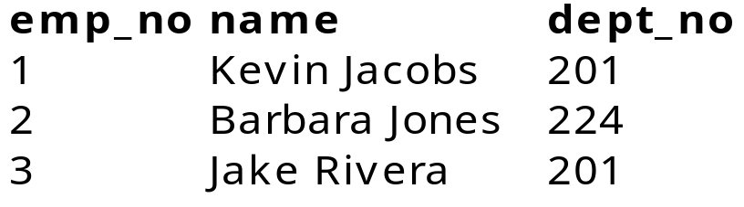
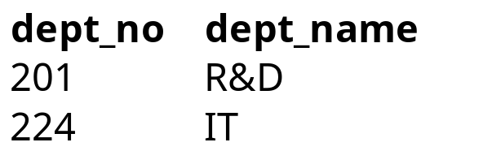
Third Normal Form (3NF)
Example 2:
Skills(3NF)
Employee (2NF)
Employee (3NF)
Department (3NF)

Slide 38
Boyce-Codd Normal Form (BCNF)
When a relation has more than one candidate key, anomalies may result even though the relation is in 3NF
3NF does not deal satisfactorily with the case of a relation with overlapping candidate keys i.e. composite candidate keys with at least one attribute in common
BCNF is based on the concept of a determinant
A determinant is any attribute (simple or composite) on which some other attribute is fully functionally dependent
A relation is in BCNF if, and only if, every determinant is a candidate key

Slide 39
Consider the following relation and determinants
R(a, b, c, d)
a, c → b, d
a, d → b
Here, the first determinant suggests that the primary key of R could be changed from a, b to a, c
If this change was done all of the non-key attributes present in R could still be determined, and therefore this change is legal
However, the second determinant indicates that a, d determines b, but a, d could not be the key of R as a, d does not determine all of the non key attributes of R (it does not determine c)

Slide 40
We would say that the first determinant is a candidate key, but the second determinant is not a candidate key, and thus this relation is not in BCNF (but is in 3rd normal form)
:
DB(Patno , appNo,time,doctor)
R1(Patno , PatName)
Consider the determinants:
Patno → PatName
Patient No | Patient Name | Appointment Id | Time | Doctor
1 | John | 0 | 09:00 | Zorro
2 | Kerr | 0 | 09:00 | Killer
3 | Adam | 1 | 10:00 | Zorro
4 | Robert | 0 | 13:00 | Killer
5 | Zane | 1 | 14:00 | Zorro
Fig 5.11

Slide 41
Patno is present in DB, but not PatName, so not relevant
Patno, appNo → Time, doctor
All LHS attributes present, and time and doctor also present, so relevant
Is this a candidate key? Patno, appNo is the key, so this is a candidate key. Thus this is OK for BCNF compliance
Time -> appNo
Time is present, and so is appNo, so relevant. Is this a candidate key? No
So DB is not in BCNF

Slide 42
BCNF: rewrite to
DB(Patno , time ,doctor)
R1(Patno , PatName)
R2(time , appNo)
Now BCNF is satisfied

Slide 43
Boyce–Codd Normal Form (BCNF)
The relation ClientInterview stores information on client interviews by members of staff.
clientNo | interviewDate | interviewTime | staffNo | roomNo
CR76 | 13-May-05 | 10:30 | SG5 | G101
CR56 | 13-May-05 | 12:00 | SG5 | G101
CR74 | 13-May-05 | 12:00 | SG37 | G102
CR56 | 1-Jul-05 | 10:30 | SG5 | G102
The relation has 3 candidate keys: (clientNo, interviewDate),
(staffNo, interviewDate, interviewTime), and
(roomNo, interviewDate, interviewTime).
The 3 composite candidate keys share a common attribute interviewDate

Slide 44
BCNF - Example
We select (clientNo, interviewDate) to be the primary key:
ClientInterview (clientNo, interviewDate, interviewTime, staffNo, roomNo)
The relation has the following functional dependencies:
Fd1: clientNo, interviewDate , interviewTime→ staffNo, roomNo
Fd2: staffNo, interviewDate, interviewTime → clientNo
Fd3: roomNo, interviewDate, interviewTime →staffNo, clientNo
Fd4: staffNo, interviewDate → roomNo
The determinants in Fd1, Fd2 and Fd3 are candidate keys but Fd4 is not. This means the relation is not in BCNF. As a consequence the relation may suffer from update anomalies. For example, to change the roomNo for staff SG5 on the 13-May-05 we must update two rows otherwise we will have inconsistency in the table.
To transform the relation to BCNF we must remove the violating functional dependency by splitting the original relation into two new relations:
Interview (clientNo, interviewDate, interviewTime, staffNo)
StaffRoom (staffNo, interviewDate, roomNo)
Note: in creating these 2 BCNF relations we have lost Fd3, as the
determinant for this dependency is no longer in the same relation.
The decision of whether to stop at 3NF or BCNF is dependent on
the amount of redundancy resulting from the presence of Fd4 and
the significance of the loss of Fd3.

Slide 45
Fourth Normal Form (4NF)
4NF: A relation that is in Boyce-Codd Normal Form and contains no MVDs.
BCNF to 4NF involves the removal of the MVD from the relation by placing the attribute(s) in a new relation along with a copy of the determinant(s).
multi-valued dependency(MVD)
Represents a dependency between attributes (for example, A, B, and C) in a relation, such that for each value of A there is a set of values for B, and a set of values for C. However, the set of values for B and C are independent of each other.

Slide 46
Multiple valued dependency—
Example of a multi-valued dependency is a field containing a comma-delimited list or collection of some kind.
A collection could be an array of values of the same type.
Those multiple values are dependent as a whole on the primary key, as a whole meaning the entire collection in the comma delimited list.
More precisely, a trivial multi-valued dependency occurs between two fields when they are the only two fields in the table.
One is the primary key and the other the multi-valued list.
A trivial multi-valued dependency is shown in the lower-right of the diagram in Figure 4-6.
A non-trivial, multi-valued dependency occurs when there are other fields in the table as shown by the top data diagram in the upper-right of Figure 4-6.

Slide 47
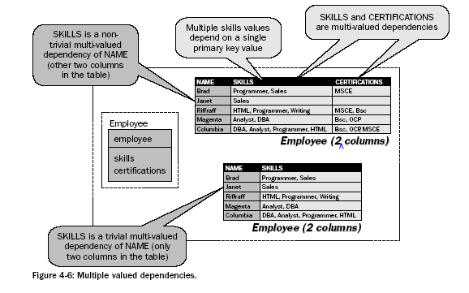

Slide 48
Multi-valued dependencies must be transformed into functional dependencies. This implies that one value and not multiple values are dependent on a primary key.
Eliminate multiple sets of multiple valued or multi-valued dependencies, sometimes described as non-trivial multi-valued dependencies.

Slide 49
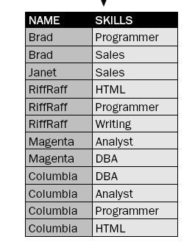
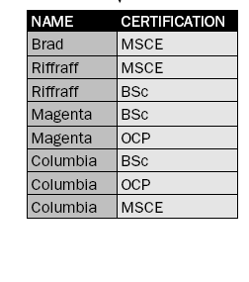

Slide 50
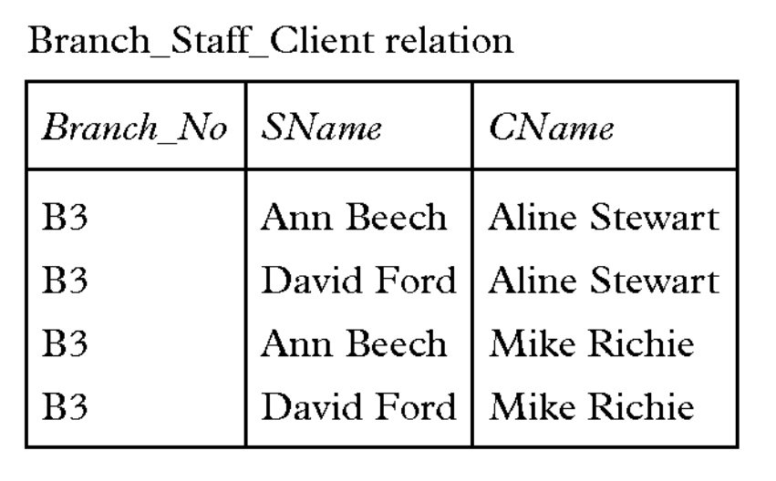
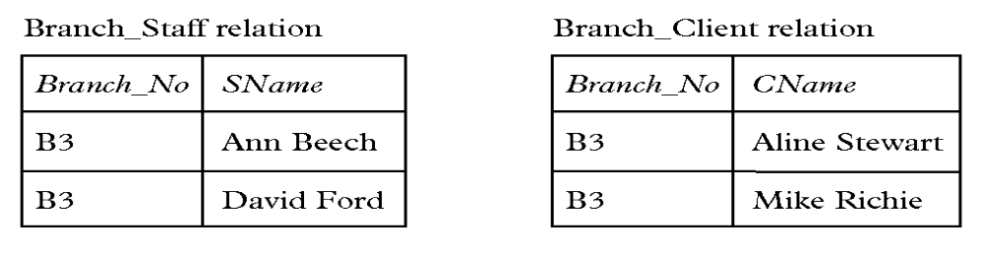
49

Slide 51
Lossless Decompositions
A decomposition is lossless if we can recover:
R(A,B,C)
R1(A,B) R2(A,C)
R’(A,B,C) should be the same as
R(A,B,C)
Decompose
Recover
R’ is in general larger than R. Must ensure R’ = R
Sometimes the same set of data is reproduced:
(Word, 100) + (Word, WP) → (Word, 100, WP)
(Oracle, 1000) + (Oracle, DB) → (Oracle, 1000, DB)
(Access, 100) + (Access, DB) → (Access, 100, DB)
Name | Price | Category
Word | 100 | WP
Oracle | 1000 | DB
Access | 100 | DB
Name | Price
Word | 100
Oracle | 1000
Access | 100
Name | Category
Word | WP
Oracle | DB
Access | DB

Slide 52
Sometimes it’s not:
Category | Name
WP | Word
DB | Oracle
DB | Access
What’s
wrong?
Name | Price | Category
Word | 100 | WP
Oracle | 1000 | DB
Access | 100 | DB
Category | Price
WP | 100
DB | 1000
DB | 100
(Word, WP) + (100, WP) → (Word, 100, WP)
(Oracle, DB) + (1000, DB) → (Oracle, 1000, DB)
(Oracle, DB) + (100, DB) → (Oracle, 100, DB)
(Access, DB) + (1000, DB) → (Access, 1000, DB)
(Access, DB) + (100, DB) → (Access, 100, DB)
Ensuring lossless decomposition
R(A₁, ..., A_{n}, B₁, ..., B_{m}, C₁, ..., C_{p})
R₁(A₁, ..., A_{n}, B₁, ..., B_{m})
R₂(A₁, ..., A_{n}, C₁, ..., C_{p})
If A₁, ..., A_{n} → B₁, ..., B_{m} or A₁, ..., A_{n} → C₁, ..., C_{p}
Then the decomposition is lossless
Note: don’t need both
Examples:
name → price, so first decomposition was lossless
category → name and category → price, and so second decomposition was lossy

Slide 53
Dependency Preserving Decomposition
Dependency preserving decomposition :
  If R is decomposed into X, Y and Z, and we enforce the FDs that hold individually on X, on Y and on Z, then all FDs that were given to hold on R must also hold.
Projection of set of FDs F : If R is decomposed into X and Y the projection of F on X (denoted F_{X} ) is the set of FDs U → V in F⁺ (closure of F , not just F ) such that all of the attributes U, V are in X. (same holds for Y of course)
Decomposition of R into X and Y is dependency preserving if (F_{X} ∪ F_{Y} ) ⁺ = F ⁺
  i.e., if we consider only dependencies in the closure F ⁺ that can be checked in X without considering Y, and in Y without considering X, these imply all dependencies in F ⁺.
Important to consider F ⁺ in this definition:
  ABC, A → B, B → C, C → A, decomposed into AB and BC.
  Is this dependency preserving? Is C → A preserved?????
    note: F ⁺ contains F ∪ {A → C, B → A, C → B}, so…
F_{AB} contains A →B and B → A; F_{BC} contains B → C and C → B
So, (F_{AB} ∪ F_{BC})⁺ contains C → A

Slide 54
5th Normal Form (5NF)
A table must be in 4NF.
Cyclic (or) join dependencies must be eliminated.
A cyclic dependency is simply something that depends on one thing, where that one thing is either directly in indirectly dependent on itself.
5NF is also known as Projection Normal Form (PJNF).
  The term “projection” is used to describe new tables containing subsets of data from the original table.
A cyclic dependency is a form of circular dependency where three pairs result as a combination of a single three-field composite primary key table, those three pairs being field 1 with field 2, field 2 with field 3, and field 1 with field 3.
The cyclic dependency is that everything is related to everything else, including itself.
5NF is similar to 4NF in that both attempt to minimize the number of fields in composite keys.

Slide 55
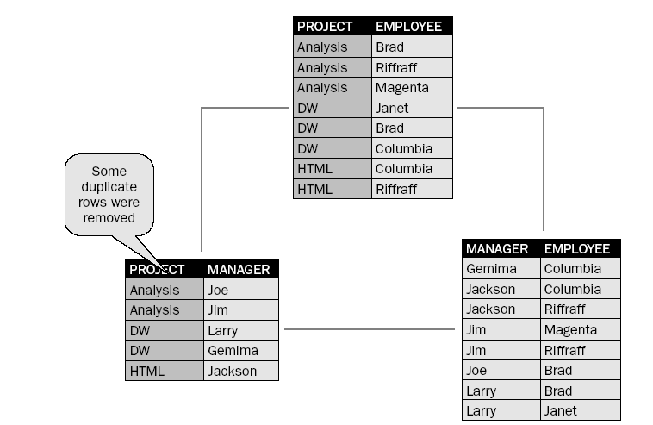
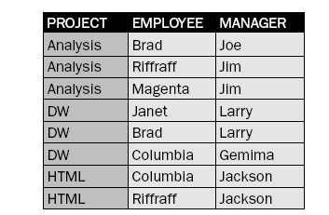

Slide 56
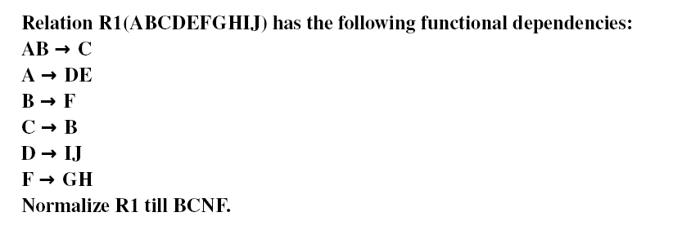
Normalization

Slide 57
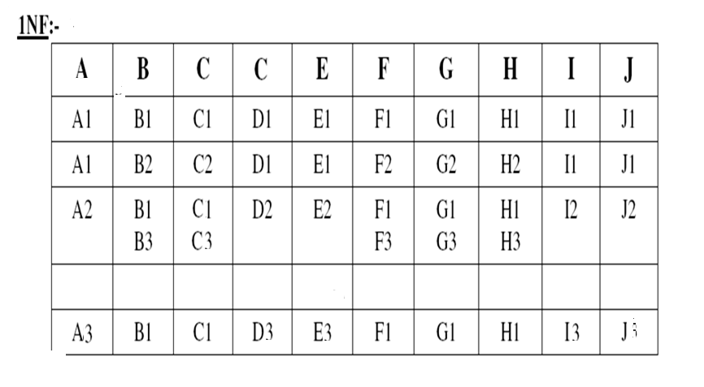

Slide 58
Above relation violates 1NF because it has:
Attributes whose values are nonatomic : B, F, G and H
Columns that do not have a unique name : 3rd and 4th column are named as C
Rows that are identical : 1st and 5th rows
Rows that have no values at all : 4th row

Slide 59
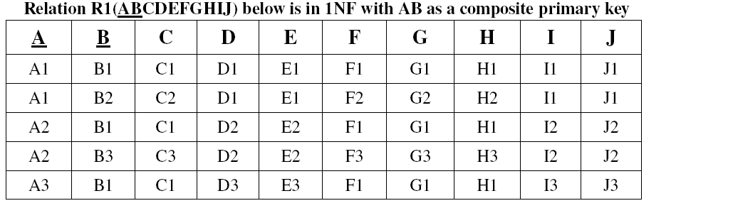

Slide 60
2NF:
R1 violates 2NF as it contains partial dependencies A → DEIJ and B → FGH.
So whenever A contains redundant values then values in DEIJ also become redundant.
Similarly whenever B contains redundant values then values in FGH also become redundant.
So remove DEIJ from R1 and put them in a new relation R2 along with a copy of their determinant i.e. A. Make A as primary key in R2 and foreign key in R1.
Similarly remove FGH from R1 and put them in a new relation R3 along with a copy of their determinant i.e. B. Make B as primary key in R3 and foreign key in R1.

Slide 61
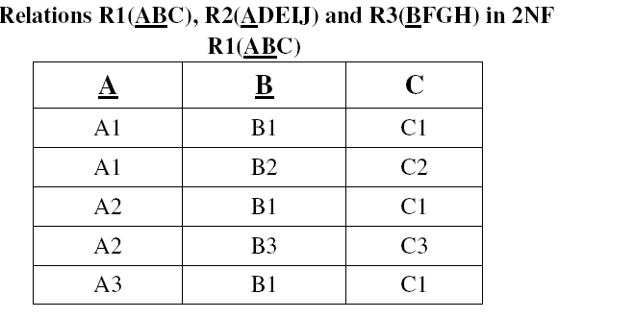

Slide 62
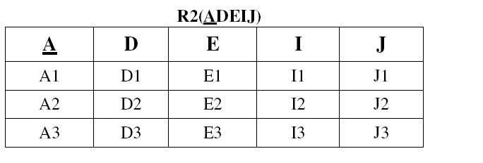
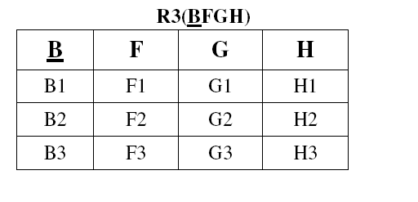

Slide 63
3NF:
R2 and R3 violate 3NF as they contain transitive dependencies D → IJ and F → GH respectively.
So whenever D contains redundant values then values in IJ also become redundant.
Similarly whenever F contains redundant values then values in GH also become redundant.
  So remove IJ from R2 and put them in a new relation R4 along with a copy of their determinant i.e. D. Make D as primary key in R4 and foreign key in R2.
  Similarly remove GH from R3 and put them in a new relation R5 along with a copy of their determinant i.e. F. Make F as primary key in R5 and foreign key in R3.
Relations R1(ABC), R2(ADE), R3(BF), R4(DIJ) and R5(FGH) in 3NF

Slide 64
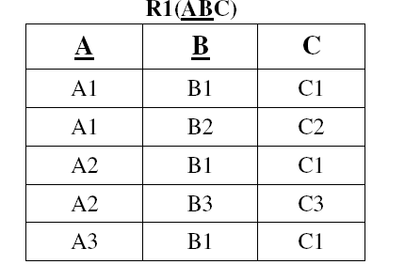

Slide 65
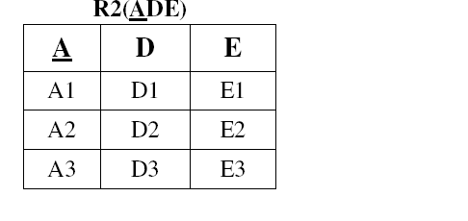
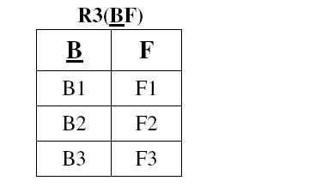

Slide 66
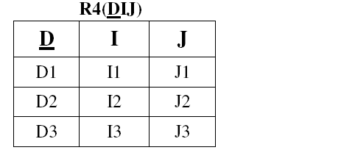
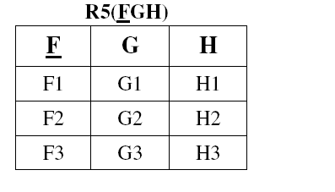

Slide 67
BCNF:
R1 violates BCNF as it contains a dependency C → B where the determinant C is a nonkey.
So whenever C contains redundant values then values in B also become redundant.
  – So remove B from R1 and put it in a new relation R6 along with a copy of its determinant i.e. C.
– Make C as primary key in R6 and foreign key in R1.
– Make AC as primary key in R1.
Relations R1(AC), R2(ADE), R3(BF), R4(DIJ), R5(FGH) and R6(CB) in BCNF
R1(AC)

Slide 68
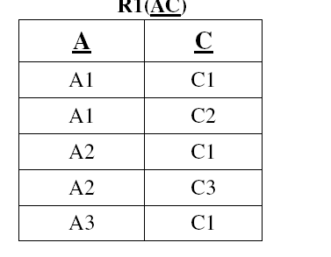

Slide 69
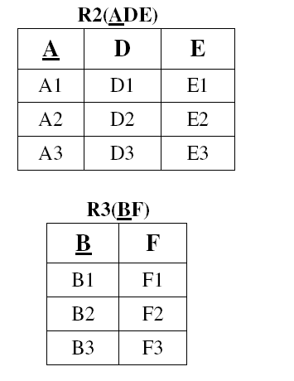
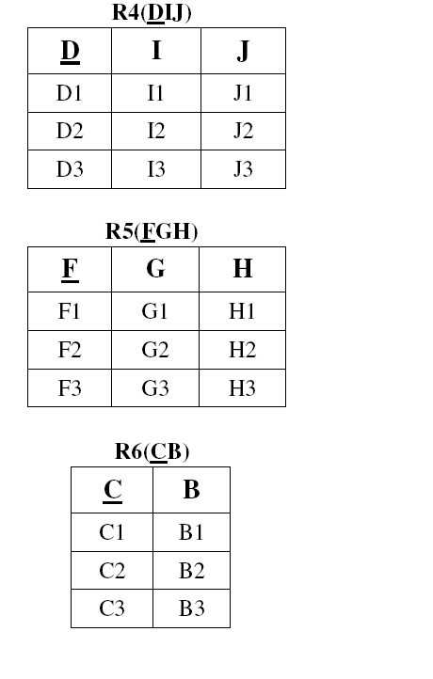

Slide 70
Assignment – 4
Normalize the relation R(A,B,C,D,E,F,G,H) into the third normal form using the following set of FDs:
AB− > C BC− > D CDE− > ABH BH− > A D− > EF
Is the decomposition dependency preserving?
2. (a) Suppose the scheme R =(A,B,C,D,E) decomposed into R1(A,B,C) and
R2(A,D,E).
The following set of functional dependencies hold.
A− > BC CD− > E B− > D E− > A
Give a lossless-join , dependency-preserving decomposition of the
scheme R into BCNF.
(b) Show that if a relation scheme is in BCNF, then it is also in 3NF.
(a) Explain the functional dependencies and multi valued dependencies
with examples.
(b) What is normalization? Discuss the 1NF,2NF, and 3NF Normal forms
with examples.
4. (a) Explain why 4NF is more desirable Normal Form than BCNF
(b) Consider the relation R(A,B,C,D,E) and FD’s
A− > BC C− > A D− > E F− > A E− > D
Is the Decomposition R in to R1(A,C,D) , R2(B,C,D) and R3(E,F,D) loss
less? Explain the requirement of lossless decomposition.

Slide 71
5.(a) What is normalization? What are the advantages and disadvantages of
Normalization?
(b) Define Boyce-codd normal form. Give a table which is in BCNF and
substantiate.
Compute the close of the following set F of functional dependences of
relation schema R=(A, B, C, D, E) A − > BC, CD − > E, B − > D, E − > A. list the candidate keys for R.
7. For the following relation scheme, tell whether it is in 3 NF or not.
Employee (E_code,E_name,Dname,salary,projectno,Termination_date of
_project) Where each project no has unique termination-date of-project.
Justify your answer, if it in not 3NF bring it into 3NF through
normalization.
8. What is multivalued dependencies? What type of constraint does it
specify ? When does it arise?
9. What is dependency preservation property for decomposition? Explain
why is it important.
10. (a) What is join dependency? How is it different to that of multivalued
dependency and functional dependency? Give an example for join
dependencies and multivalued dependencies
(b) When are two sets of functional dependencies are equivalent? How
can we determine their equivalence?

